Slide 1
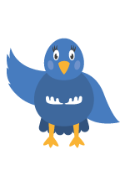
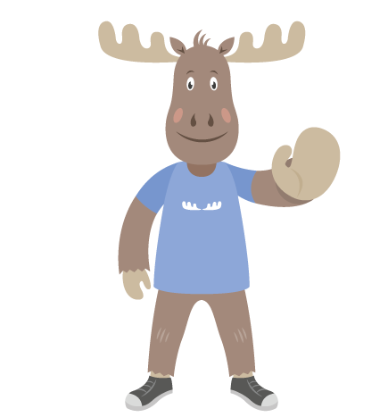
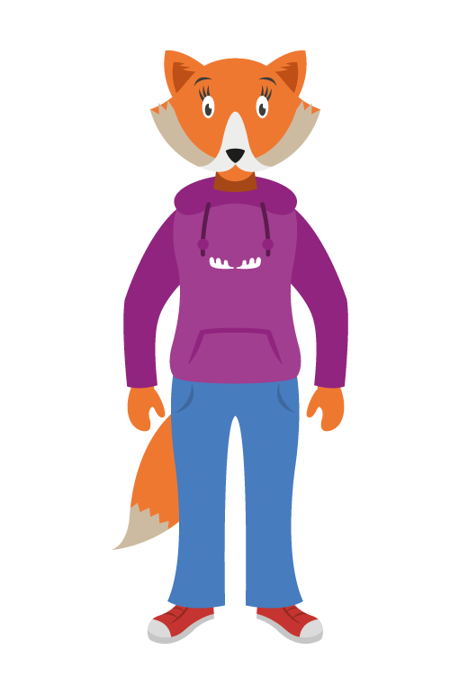
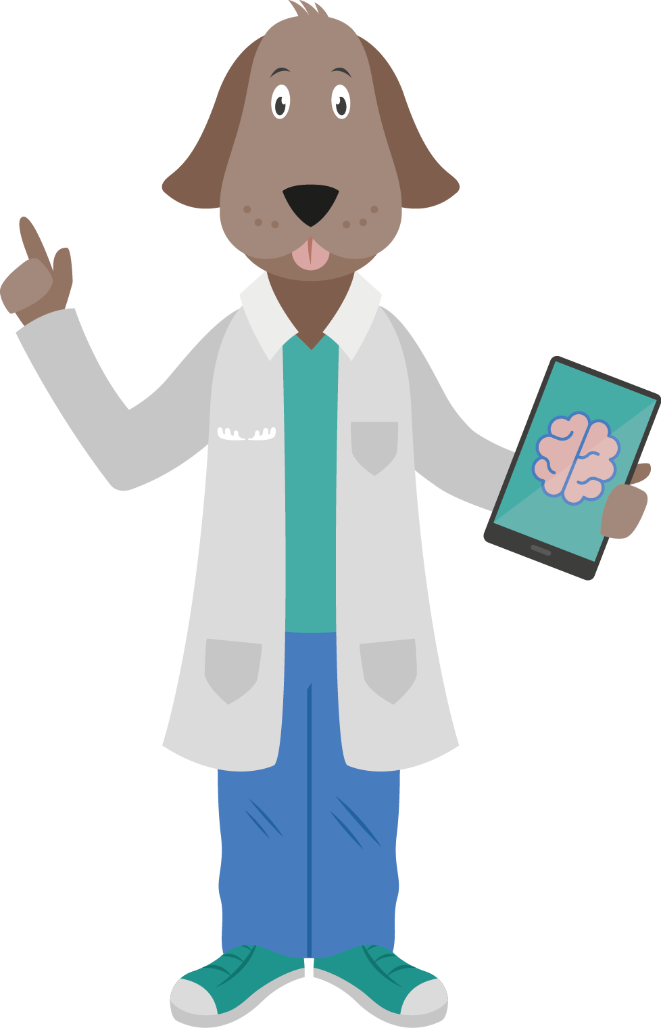
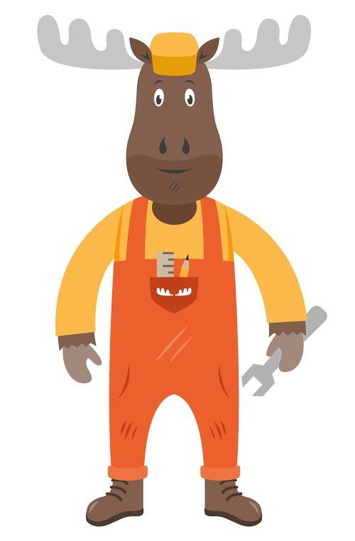
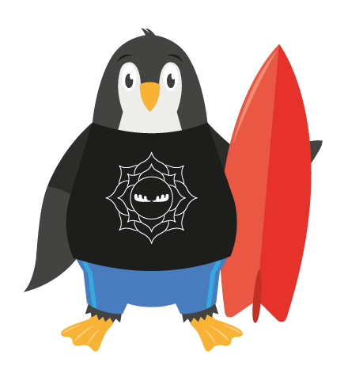
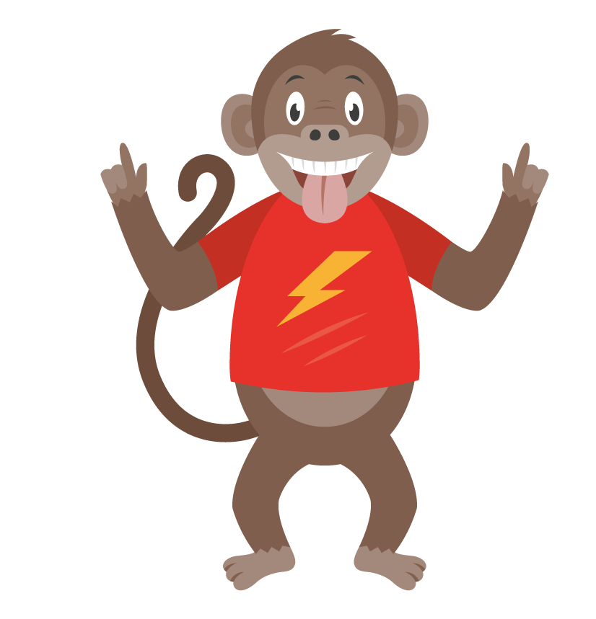
Looking after our Mental Health
With Mind Moose and friends
www.mindmoose.co.uk

Slide 2
What is physical health?
Physical health is about looking after our bodies to help us grow and stay healthy.
How can we look after our
physical health?
Notes:
What is our physical health?
Ask the children what they think physical health is. Click for a definition.
Ask them to give a few suggestions of how to look after our physical health (eg. eat healthily, stay active etc).

Slide 3
Why do we look after our physical health?
Keeps us healthy
Helps to keep us free from illness
Keeps us strong
Keeps us fit
Keeps us happy
Notes:
Invite pupils to answer the question, then show the suggestions & talk through

Slide 4
Looking after our mental health
A healthy mind is as important as a healthy body!

Slide 5
What do we mean by mental health?
Mental health means keeping our minds healthy.
Having good mental health
helps us feel good about
ourselves and cope with life’s
ups and downs.
Notes:
Ask pupils to share their ideas, then show & discuss

Slide 6
How can we look after our mental health?
Eating well
Sleeping well
Drinking plenty of water
Talking to people we trust about how we feel
Doing activities we enjoy
Having good friends
Working towards our goals
Notes:
Ask for suggestions, then explain these are some ways.
Point out that the top 3 are very similar to looking after our physical health.

Slide 7
Problems with our mental health
Just like our bodies can get ill, so can our minds.
We can have problems with our
mental health - just like our
physical health.
That’s ok

Slide 8
We can help each other to look after our mental health by...
Talking
Listening
Telling

Slide 9
Talking
About how we are feeling
Being honest about our feelings
Asking our friends if we think something is wrong
Asking a trusted adult to help us
Use kind words to others
Telling somebody that you care
Notes:
Invite children to share how they think talking might help.
Then reveal & discuss answers

Slide 10
Listening
Being supportive friends to each other
Taking time to listen to each other
Being kind to each other and ourselves
Listening when somebody needs to talk
Notes:
Invite children to share how listening could help.
Share & discuss points

Slide 11
Telling
Telling a teacher or adult you trust if you are worried about something
Tell someone even if you are not sure
If something feels difficult to tell, it might be even more important to tell.
Notes:
Invite pupils to share how telling might be helpful, then show points & discuss.

Slide 12
So remember:
We all have physical and mental health.
There are ways we can look after our minds and bodies.
Talking, listening and telling can help.
Being kind to each other is important.

Slide 13
Activity
Create a poster or a poem about one of the things you have learnt in assembly.
Notes:
Teachers in class could decided to choose one aspect from the presentation to concentrate on in class and could ask the children to prepare posters and/or poems to help promote positive physical and mental health in school.
You could make a display from the children’s work.

